Slide 1

PRESENTED BY:-
GROUP - 2
ROHIT
SWATHI
ROSHAN
SAIKIRAN
VISHAL
VILAS
TOOLS USED :-
EXCEL
TABLEAU
SQL
POWER BI

Slide 2

COMPANY OVERVIEW
Adventure Works Cycles is a fictional manufacturing company created by Microsoft for learning and demonstrating business intelligence, data analytics, and database management concepts.
Industry: Bicycle manufacturing and retail
Products: Bikes, components, clothing, accessories
Business Model: B2B (resellers) + B2C (direct customers)
Purpose: Used as a standard dataset for tools like SQL, Power BI, Excel, and Tableau

Slide 3

DATASET OVERVIEW
Dataset : Adventure Works Main Data
Customer | Date | Product | Category | Subcategory| Sales Territory | New Sales | Old Sales
Data Includes information such as:
Product details
Sales orders
Customer information
Order quantity
Unit price
Unit cost
Discount
This data helps analyze business performance using calculations, charts and dashboards.

Slide 4
OBJECTIVE OF THE STUDY
To analyze sales performance of Adventure Works.
To evaluate profit and cost structure.
To identify top-performing products.
To analyze monthly and yearly sales trends.
To understand regional sales performance.
To provide suggestions for improving business performance.
Key Focus Areas:
Sales Performance
Customer Behavior
Product Analysis
Operational Efficiency

Slide 5
Tools & Technologies Used
Excel: Used for data cleaning, transformation, and building relationships. Applied Pivot Table for analysis and created charts for initial insights.
Power BI: Used for data modeling and creating DAX measures. Built interactive dashboards with KPI cards, performed trend analysis, customer segmentation, and developed business reports.
Tableau: Used to design interactive dashboards and create effective data visualizations. Performed trend analysis and enabled user-driven insights through filters and interactions.
SQL: Used for data extraction and querying. Applied joins, aggregations, filtering, and subqueries to analyze data and calculate key performance indicators (KPIs).

Slide 6

DATA PREPARATION
Performed data cleaning by removing duplicates and correcting errors
Standardized data formats, including date and numeric fields
Applied data transformation techniques to create calculated fields (e.g., profit)
Conducted data aggregation for year-wise and region-wise analysis
Ensured data accuracy through validation and quality checks

Slide 7


FUNCTIONS AND CALCULATIONS USED
Excel Calculations & Analysis:
Calculated Sales Amount: Unit Price × Order Quantity − Discount
Computed Production Cost: Unit Cost × Order Quantity
Derived Profit: Sales Amount − Production Cost
Used Pivot Tables to summarize sales by year, month, and region
Power BI Calculations:
Created DAX measures for KPIs such as Total Profit and Profit Margin
Enabled dynamic analysis through calculated metrics and interactive dashboards

Slide 8


Tableau Calculations:
Created calculated fields for Sales, Profit, and Profit Ratio
Applied table calculations (running totals, percentage growth) for trend analysis
Supported interactive dashboards with dynamic calculations
SQL Calculations:
Calculated Sales, Cost, and Profit using SQL expressions
Used aggregations (SUM, AVG) to compute total metrics
Applied GROUP BY for year-wise and region-wise analysis
Performed KPI calculations directly within queries

Slide 9
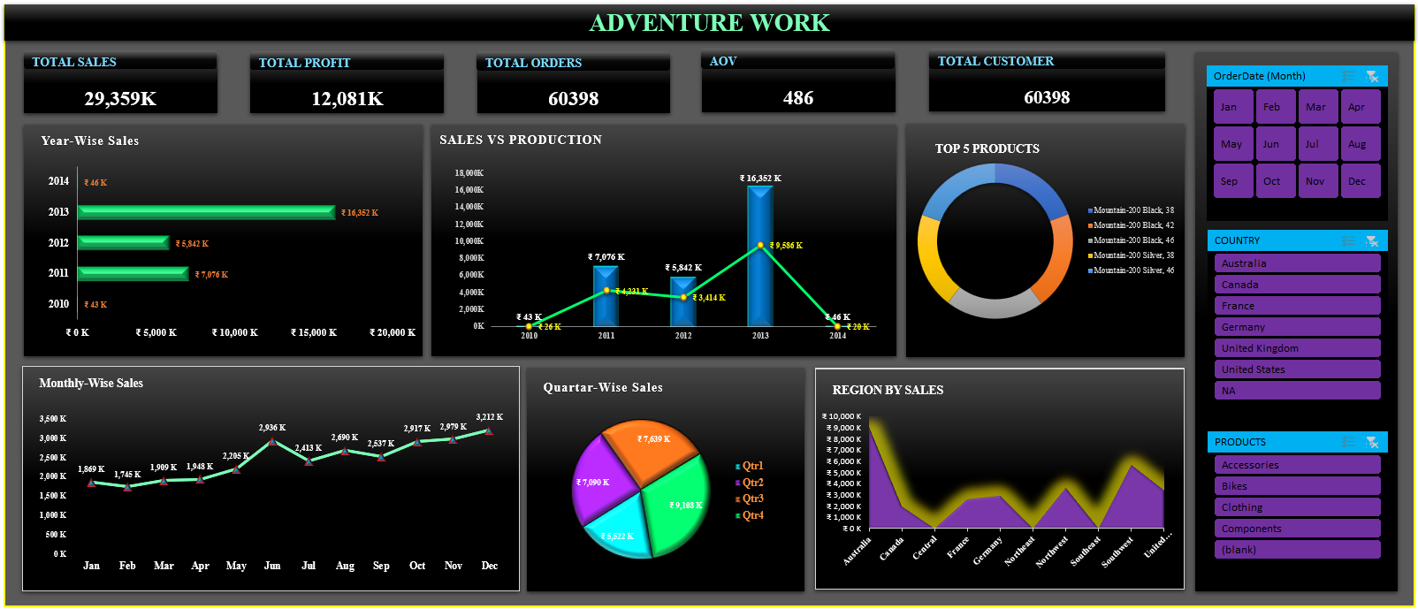
DASHBOARD OVERVIEW (EXCEL)
This dashboard provides a comprehensive view of sales performance, profitability, and customer insights, enabling data-driven decision-making.
KPIs: Tracks Total Sales (29,359K), Profit (12,081K), Orders, AOV, and Customers to measure overall performance
Sales Analysis: Year-wise and monthly trends highlight growth patterns and seasonal fluctuations
Profitability: Sales vs Production analysis shows cost efficiency and profit margins
Product Insights: Identifies top-performing products contributing to revenue
Regional Performance: Highlights sales distribution across countries to identify key markets
Interactive Filters: Allows dynamic analysis by month, region, and product category

Slide 10
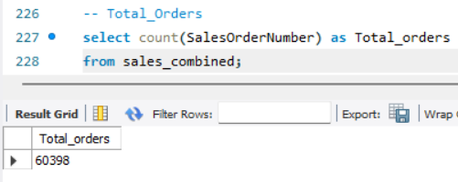
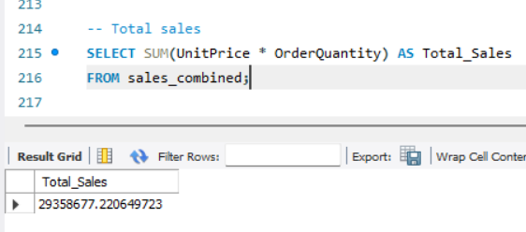
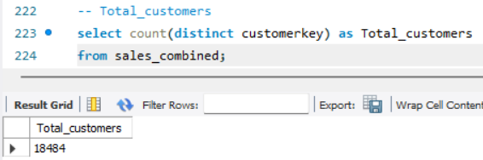
SQL QUERIES FOR KPI’s
Total Orders :
Total number of orders placed = 60,398 Indicates overall business transaction volume
Total Customers:
Unique customers = 18,484 Shows customer base size
Total Sales :
Total revenue generated = 29,358,677 Calculated using Unit Price × Order Quantity
Total Profit :
Total profit earned = 12,080,883Calculated using (Sales Amount – Cost
These KPIs help analyze business performance and growth trends.

Slide 11
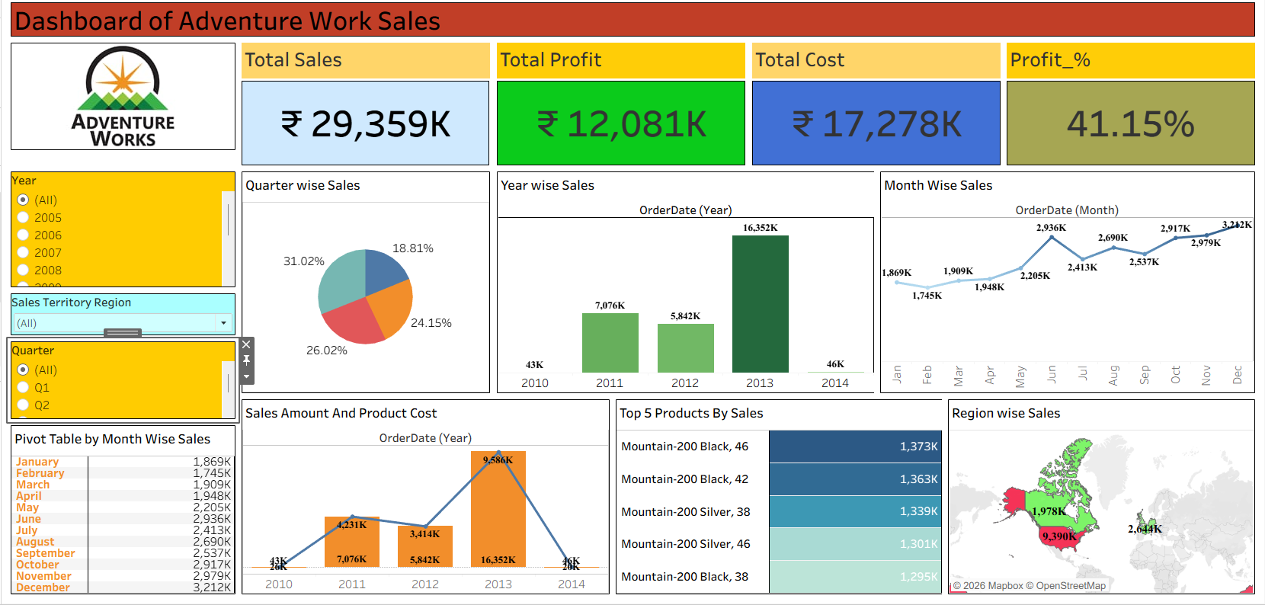
DASHBOARD OVERVIEW (TABLEAU)
The Tableau dashboard was developed to effectively visualize and analyze Adventure Works sales data through interactive charts and filters. It provides clear insights into sales trends, product performance, and regional distribution, enabling better business understanding and decision-making
Key Insights:
Sales demonstrate a consistent upward trend from 2010 to 2013, indicating business growth
The year 2013 recorded the highest overall sales performance
The Mountain Bike category is the leading contributor to total revenue
North America and Europe represent the primary revenue-generating regions
Sales exhibit seasonal variations across different months, highlighting demand fluctuations

Slide 12
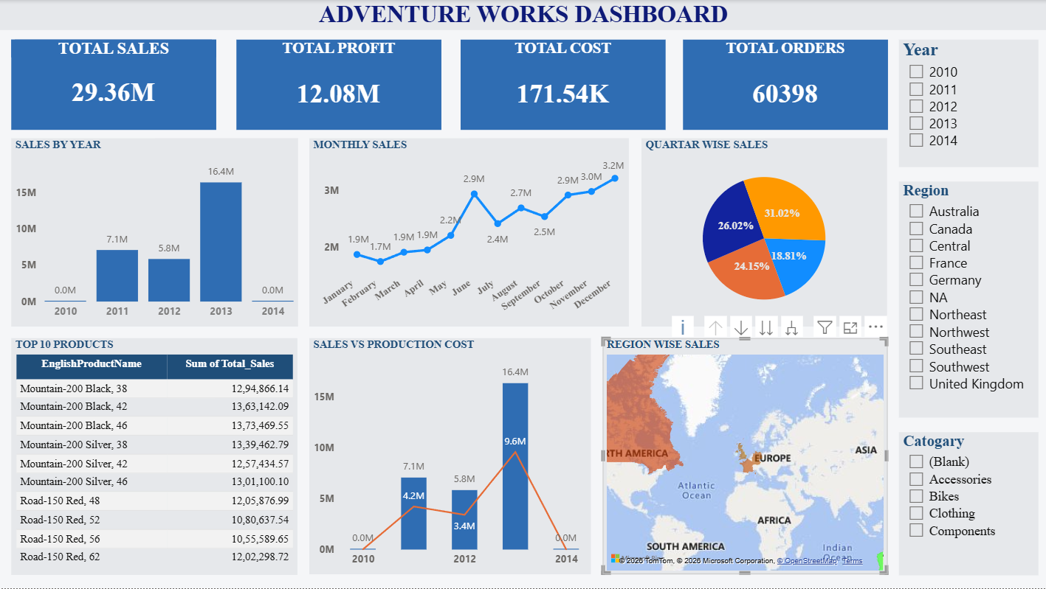
DASHBOARD OVERVIEW (POWER BI)
This dashboard analyzes Adventure Works sales data using interactive visuals and KPIs to track performance, trends, and business insights
Key KPIs:
Total Sales: ₹29.36M
Total Profit: ₹12.08M
Total Cost: ₹17.27M
Total Orders: 60,398
Key Insights:
Sales peaked in 2013, showing strong growth
December and Q4 recorded the highest sales
Mountain-200 products are top revenue drivers
Higher profitability observed due to strong sales vs cost gap
North America and Europe are key markets

Slide 13
KEY PERFORMANCE INDICATORS AND SALES ANALYSIS
Profit Margin: 41%
Total Orders: 60,398
Total Profit: ₹12.08M
Total Sales: ₹29.36M
Total Cost: ₹17.27M
Key findings from sales :
Sales increased steadily from 2010 to 2013
2013 recorded the highest sales
Sales dropped in 2014
This indicates strong growth followed by a decline.

Slide 14
PRODUCT PERFORMANCE AND REGIONAL ANALYSIS
Top selling products:
Mountain-200 Black
Mountain-200 Silver
Road-150 Series
Observation: Mountain bike category contributes the highest sales.
Major sales regions include:
North America
Europe
Australia
Observation: North America shows the highest sales contribution.

Slide 15

OBSERVATION OF THIS PROJECT
Key observations from Adventure works project :
Sales increased significantly until 2013
Profit margin is strong (around 41%)*
Mountain bike products generate highest revenue
Q4 contributes the highest sales
Some months show lower sales indicating seasonal demand
Regional sales distribution is uneven

Slide 16

SUGGESTIONS
Increase focus on high-performing
products such as Mountain bikes.
Improve marketing strategies during low-sales months.
Expand business in high-performing regions.
Optimize production cost to improve profit margin.
Strengthen sales strategies in regions with low performance.

Slide 17
CONCLUSION
The Adventure Works dashboard analysis provides valuable insights into sales performance, profit trends, and customer demand.
The dashboards created using Excel, Tableau, and Power BI help visualize data effectively and support better business decision-making.
Overall, Adventure Works shows strong profitability and growth potential if the company focuses on product strategy, cost management, and regional expansion.

Slide 18


